Slide 1

Apple
Behind the Bite: Rethinking Apple’s Icons

Slide 2
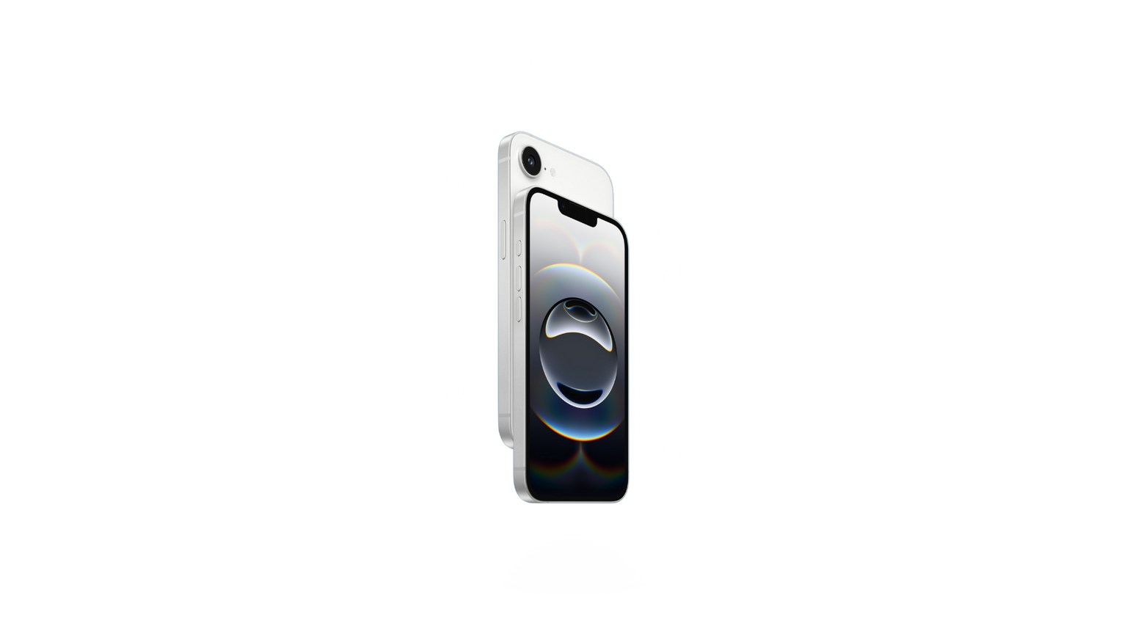
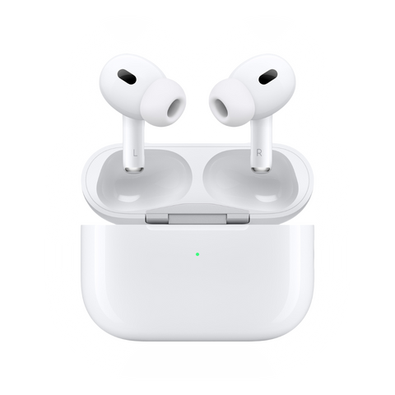
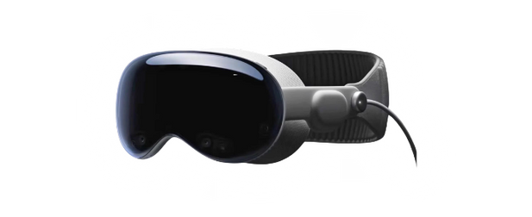

Executive Summary
Apple’s products shape culture — but perception doesn’t always match intent.
How are users really perceiving these products, and how can marketing reshape that narrative?
Behind the Bite: Rethinking Apple’s Icons

Slide 3
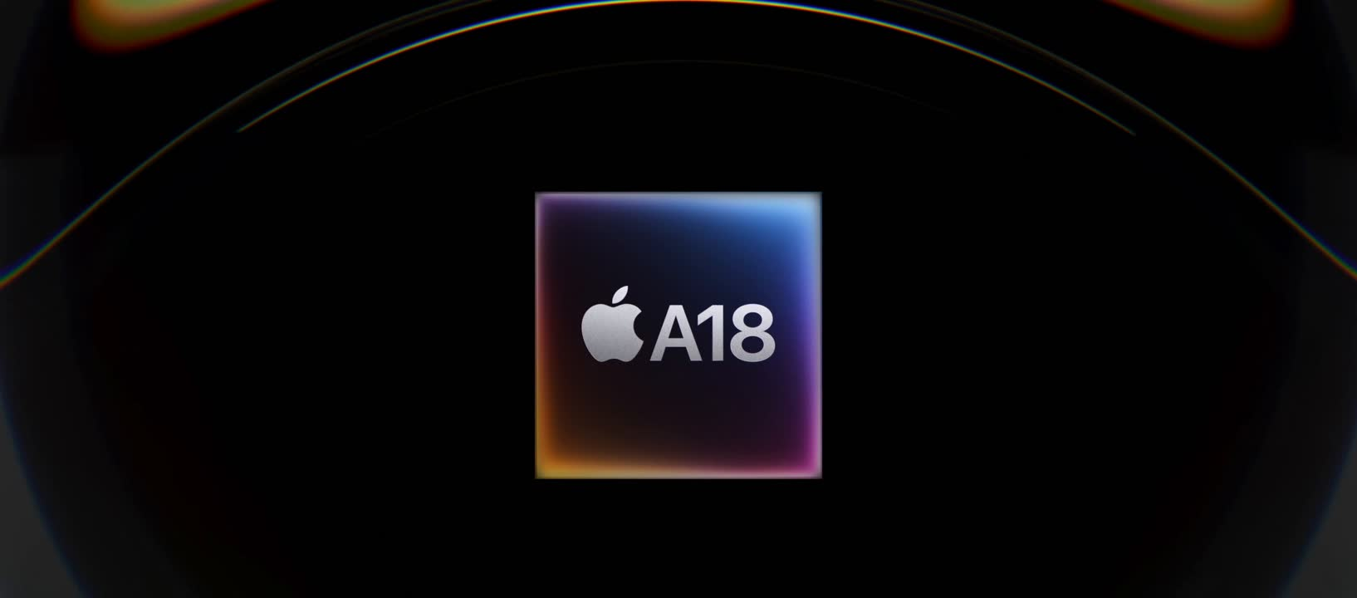
To what extent is the iPhone 16e perceived by users as a stripped-down or cheap version of Apple’s ecosystem?

Slide 4
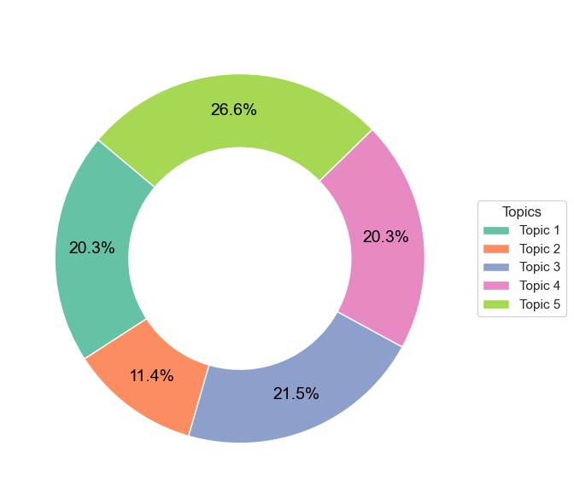
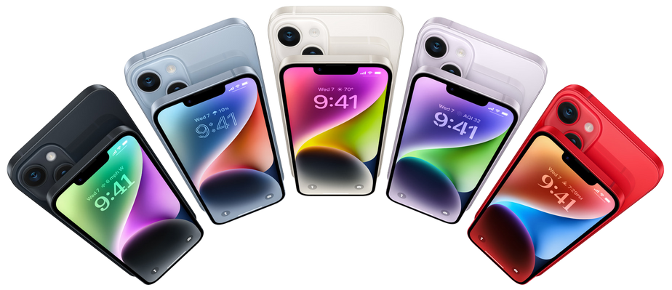
IPHONE 16E
AIRPODS PRO 2
APPLE VISION PRO
Perception as a Budget Compromise
Topic 1: Price & Camera Value
Topic 2: Cheap & Missing Features
Topic 3: Lack & Product Gaps
Topic 4: Budget vs Pro/Comparison
Topic 5: General Value & Opinion
Behind the Bite: Rethinking Apple’s Icons
Notes:
Our topic modeling and keyword analysis reveal a strong perception problem.
Both Topics 2 and 3 of user discussions center on the idea that the iPhone 16e is a stripped-down, cheap, or limited version of a ‘real’ iPhone.
Topic 4 corroborates that with comparisons between the pro models and the basic 16e one.
Words like missing, cheap, and compromise dominate. This tells us that the 16e is not seen as a clean, minimal version — it’s seen as a budget downgrade that loses the Apple identity

Slide 5
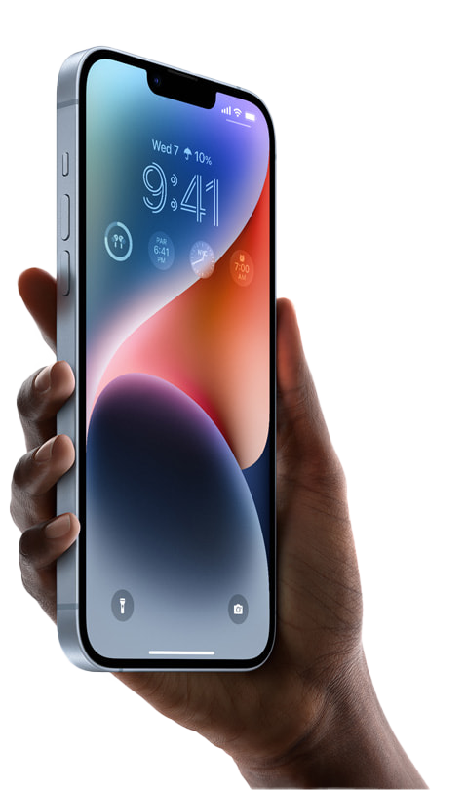
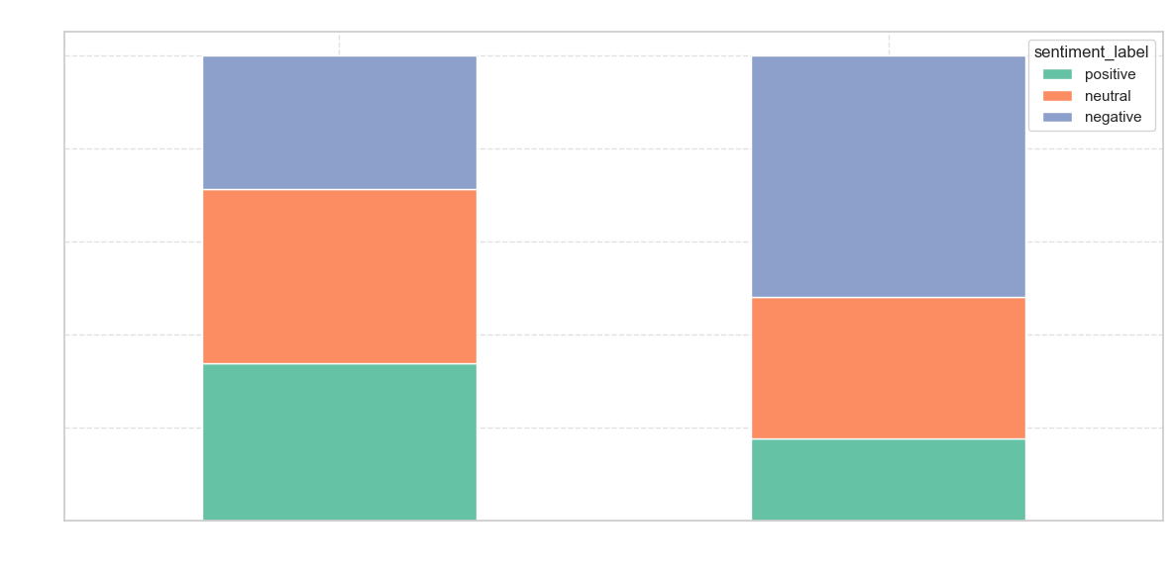
IPHONE 16E
AIRPODS PRO 2
APPLE VISION PRO
Gap Between Brand and Product
Negative sentiment makes up of total mentions
40–45%
Behind the Bite: Rethinking Apple’s Icons
Notes:
The sentiment analysis supports what we’ve seen from the topics.
In the segment where the iPhone 16e is labeled cheap, entry-level, or stripped (has keyword), sentiment turns negative in over 40%-45% of cases.
Meanwhile, value and budget-friendly narratives don’t balance out the negativity.
Users don’t just think it costs less — they feel like they’re getting less Apple

Slide 6
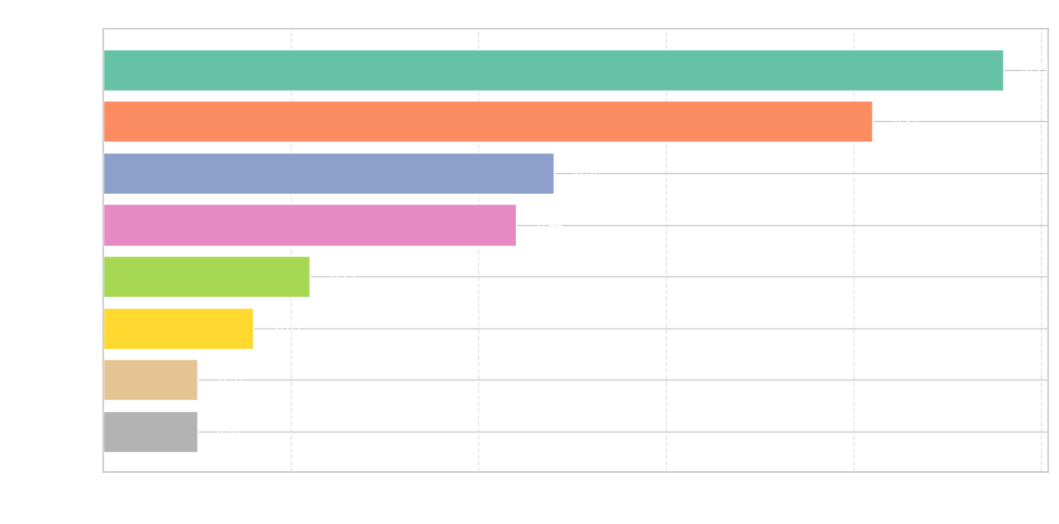
IPHONE 16E
AIRPODS PRO 2
APPLE VISION PRO
Gap Between Brand and Product
The most frequent keywords match negative tones
Behind the Bite: Rethinking Apple’s Icons
Notes:
The perception within the negative discussions about the iPhone 16e focus solely on it being a "budget" iphone with missing features, feeling cheap (as synonym for crap) while overpriced for its lacking features and low value.

Slide 7
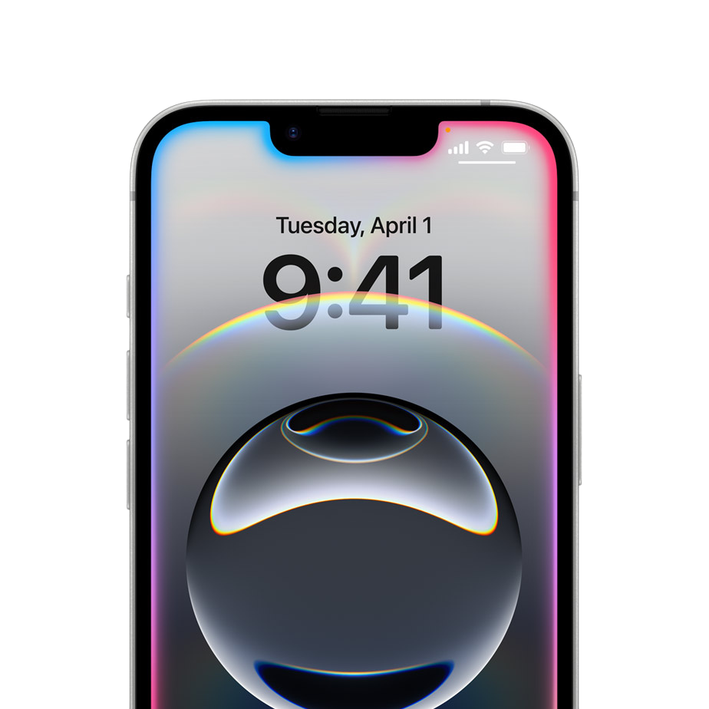
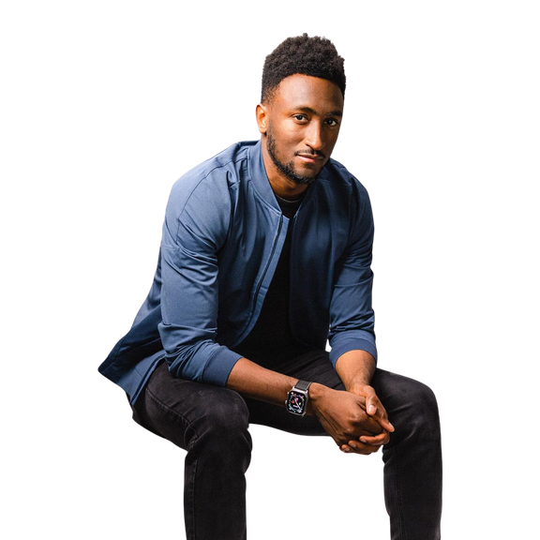
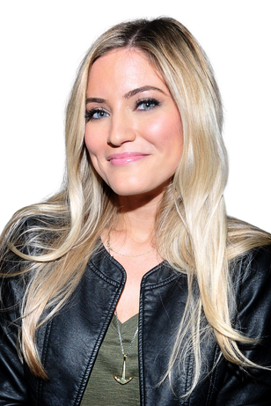
IPHONE 16E
AIRPODS PRO 2
APPLE VISION PRO
Less, by Apple
A confident, minimalist statement that mirrors Apple’s design philosophy. Think “Less is more” — but Apple’s version. Not defensive. Just bold
Creator Challenge
16e
in 16 days
iPhone 16e isn’t missing something: it’s just focused.
Influencers post videos living only with the 16e for 16 days
Behind the Bite: Rethinking Apple’s Icons
Notes:
The iPhone 16e gives you everything essential. Nothing extra. Nothing wasted.
It’s not a compromise. It’s clarity
We’re flipping the narrative.
The iPhone 16e isn’t something that lacks — it’s something that chooses.
With the ‘Less, by Apple’ campaign, we make minimalism aspirational again.
The 16e becomes a statement: that you don’t need more, just better.
Through creators, community, and clean messaging — we move this product out of the shadow of ‘cheap’ and into the light of intentional Apple simplicity
Creator Challenge: “16e in 16 Days”
Influencers (MKBHD, iJustine, Sara Dietschy, etc.) live only with the 16e for 16 days
Must show real use in their work: videos, photos, productivity, etc.
No other Apple devices allowed
Post daily clips — raw, unfiltered

Slide 8



IPHONE 16E
AIRPODS PRO 2
APPLE VISION PRO
Less, by Apple
A confident, minimalist statement that mirrors Apple’s design philosophy. Think “Less is more” — but Apple’s version. Not defensive. Just bold
Community Activation
16e
ssentials
What 16 things do you really use your phone for?
The 16e becomes a statement. You don’t need more, just better
Behind the Bite: Rethinking Apple’s Icons
Notes:
Through creators, community, and clean messaging — we move this product out of the shadow of ‘cheap’ and into the light of intentional Apple simplicity.”

Slide 9

IPHONE 16E
AIRPODS PRO 2
APPLE VISION PRO
Less, by Apple
A confident, minimalist statement that mirrors Apple’s design philosophy. Think “Less is more” — but Apple’s version. Not defensive. Just bold
KPIs
Shift keyword mentions from cheap/missing → essential/simple
Positive sentiment growth +15% in “iPhone 16e” Reddit and Youtube searches
100k+ UGC entries in “16essentials” campaign across platforms
Behind the Bite: Rethinking Apple’s Icons

Slide 10
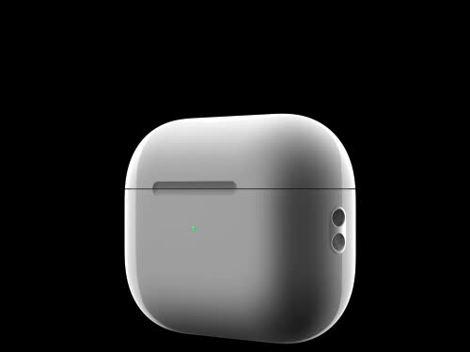
Are the AirPods Pro 2 still the kings of audio… or just an overrated accessory?

Slide 11
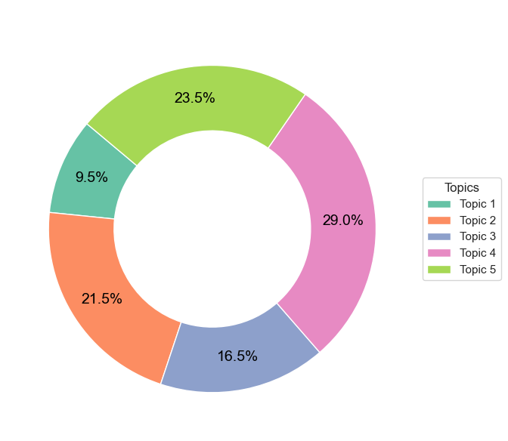
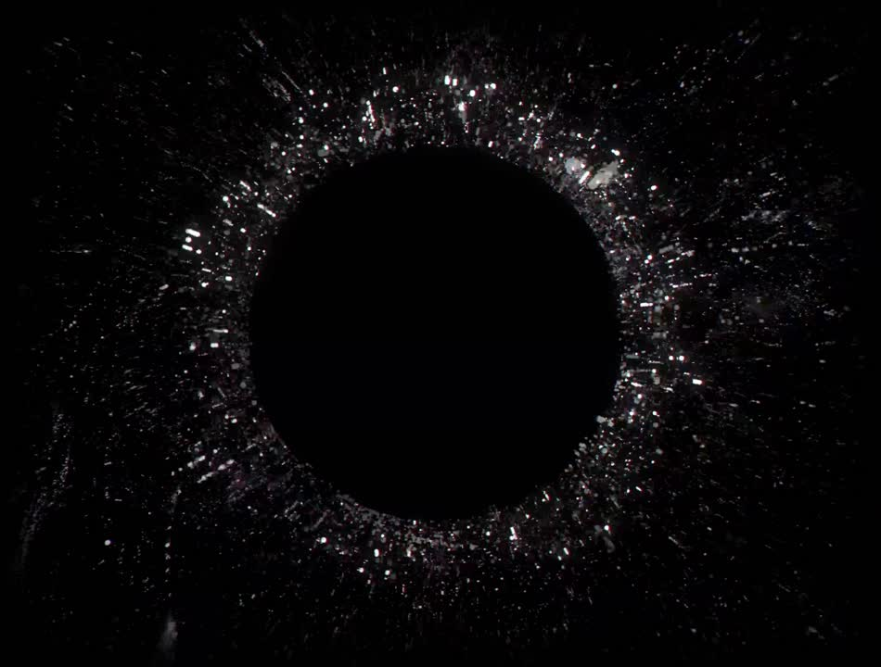
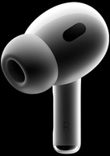
IPHONE 16E
AIRPODS PRO 2
APPLE VISION PRO
Sound Quality Reigns, but ¿Frustrations Surface?
Topic 1: Pairing Issues
Topic 2: Active Noise Cancelling Features
Topic 3: Noise Experience
Topic 4: Sound Quality Praise
Topic 5: Other Product Issues
Behind the Bite: Rethinking Apple’s Icons
Notes:
Our topic modeling and keyword analysis reveal how users praise the core strengths.
The product’s audio quality with Topic 2, 3 and 4 account for the 67% of the positive conversation.
There are some common issues like noise cancelling bugs, pairing problems, and battery life but are minoritary.

Slide 12
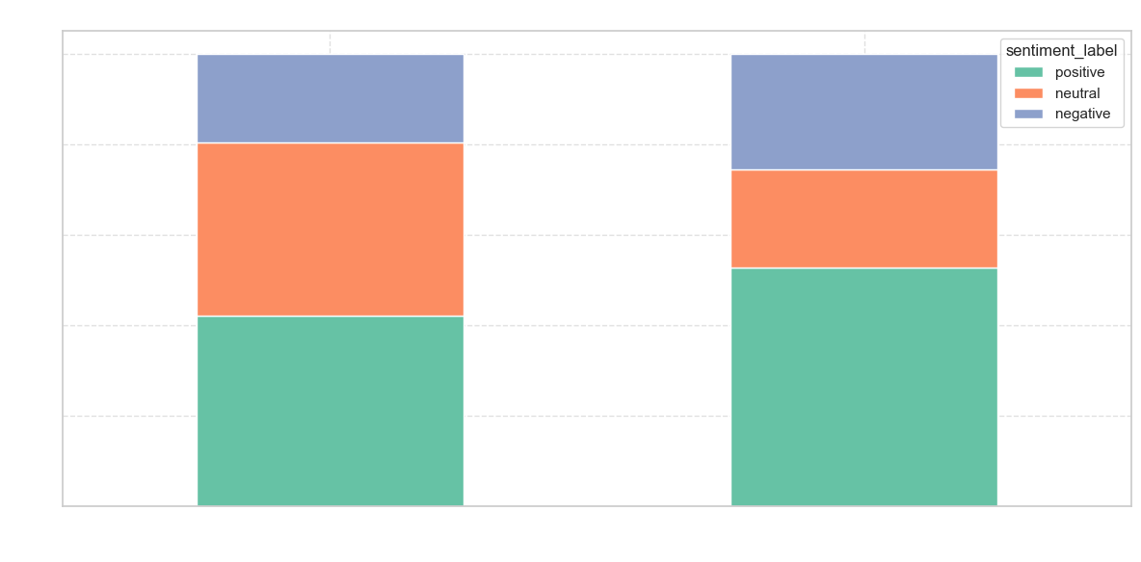
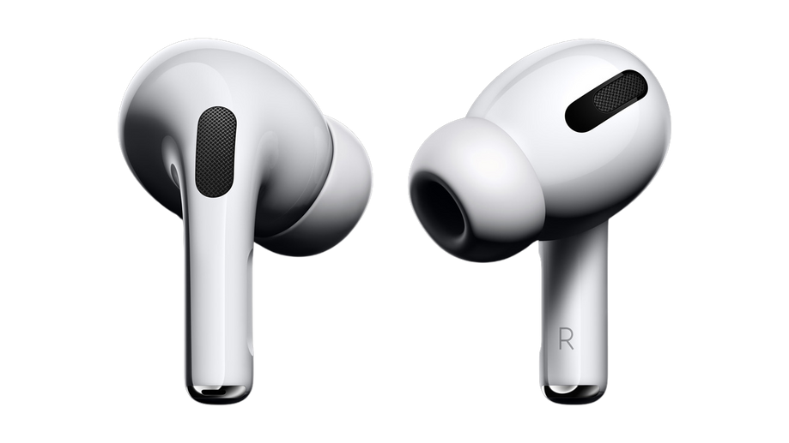
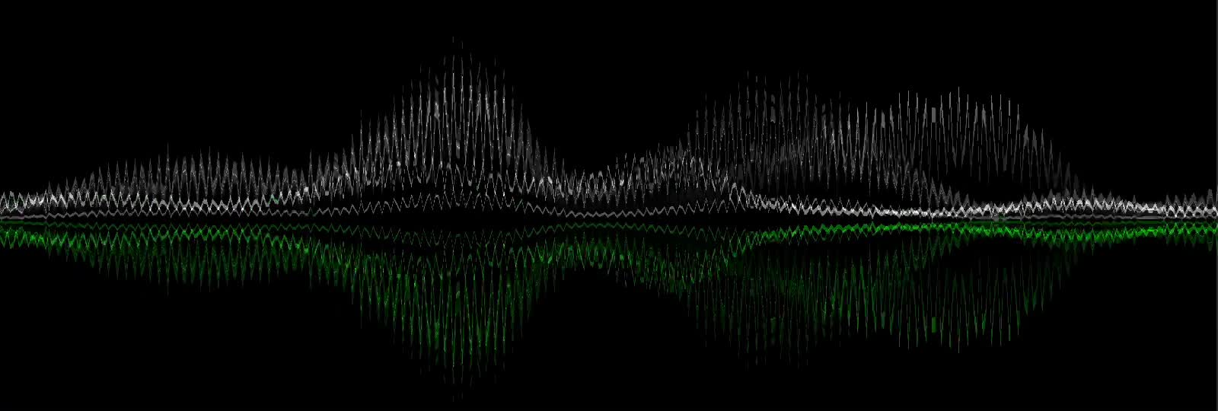
IPHONE 16E
AIRPODS PRO 2
APPLE VISION PRO
Even with Complaints, Users Remain Positive
Users express trust and satisfaction, even when discussing typical frustrations
Behind the Bite: Rethinking Apple’s Icons
Notes:
This chart is especially revealing.
We filtered the sentiment by commonly negative or functional keywords — things like problem, overpriced, battery, and noise.
And still, positive sentiment dominates.
This shows brand strength and product value resilience
Users aren’t just tolerating flaws — they still feel that overall, the AirPods Pro 2 deliver, especially in sound and integration.
The product’s reputation holds strong, even under criticism. That’s the kind of loyalty we need to leverage in the marketing campaign.

Slide 13
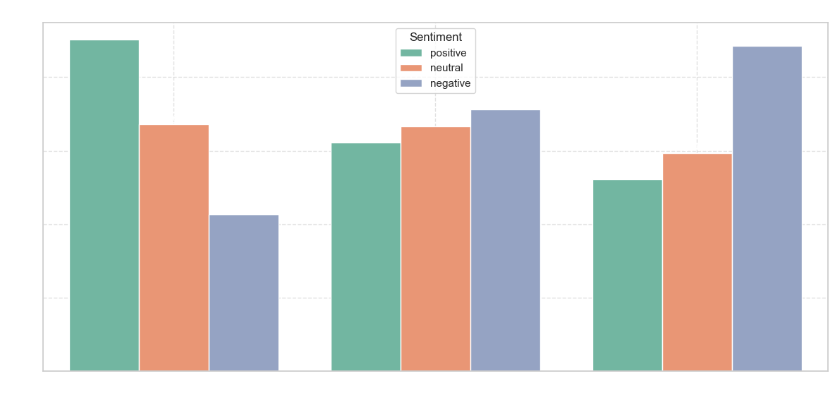
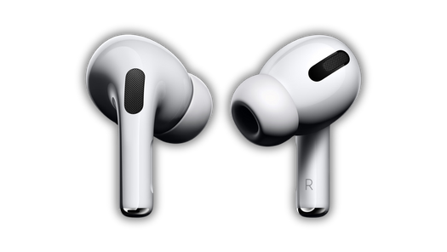
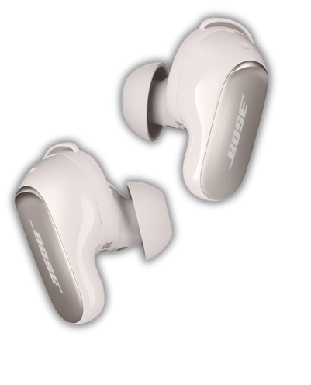
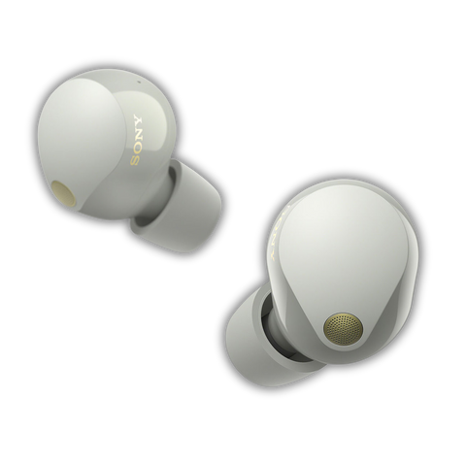
IPHONE 16E
AIRPODS PRO 2
APPLE VISION PRO
Competitor Comparison
Behind the Bite: Rethinking Apple’s Icons
Notes:
Here we compared the sentiment distribution for Apple, Sony, and Bose products.
The AirPods Pro 2 stand out with the highest percentage of positive sentiment, even though we filtered using functional keywords like problem, battery, or overpriced.
This suggests a powerful emotional loyalty: users may complain, but they still trust and recommend the product more than the competition.

Slide 14
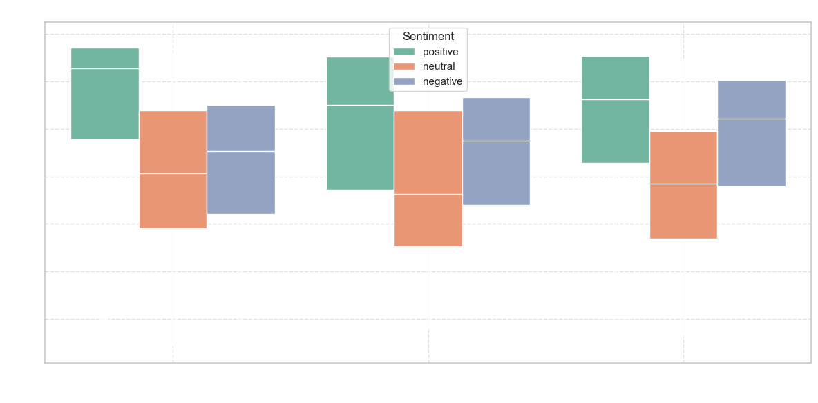
IPHONE 16E
AIRPODS PRO 2
APPLE VISION PRO
Competitor Comparison
Behind the Bite: Rethinking Apple’s Icons
Notes:
What we can see is that Apple’s sentiment scores tend to skew higher than competitors overall — especially compared to Sony, which shows a wider range including more negative outliers.
Bose shows a more balanced distribution, with less polarity — possibly indicating more consistency, but less enthusiasm.
Apple still maintains the highest upper range of sentiment, reinforcing that users feel more strongly and positively about their AirPods Pro 2 experience — even when they raise issues

Slide 15
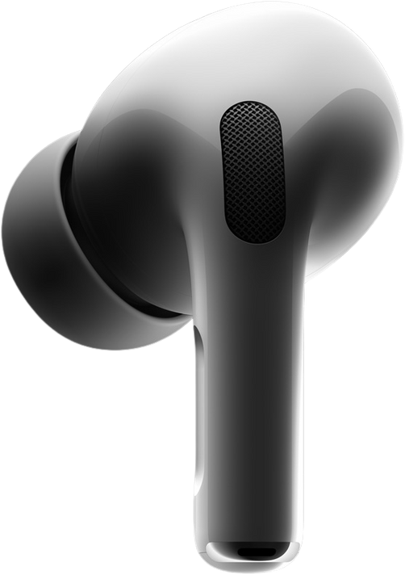


IPHONE 16E
AIRPODS PRO 2
APPLE VISION PRO
Still Pro. Always On,
by Apple
The sound you love. The performance you deserve. Wherever, whenever.
30-day “Sound Confidence” Program
We believe in the sound. You will too.
AirPods Assurance
Try AirPods Pro 2 for 30 days, if they don’t meet your expectations, return them.
INCLUDED IN-STORE, ONLINE & PROMOTED IN-BOX
Behind the Bite: Rethinking Apple’s Icons
Notes:
We’ve seen that users still love the sound, even when they mention problems — so instead of trying to defend those issues, we take a bold, Apple-style approach to remove doubt and reduce friction.
The first strategy is the 30-Day Sound Confidence Program:
Try them risk-free — no forms, no frustration. Just the message: If it doesn’t feel Pro, send it back.
That sends a powerful signal about the product’s quality and consistency.

Slide 16
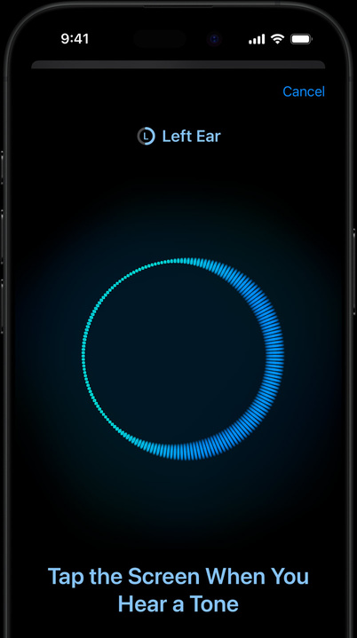

IPHONE 16E
AIRPODS PRO 2
APPLE VISION PRO
Still Pro. Always On,
by Apple
The sound you love. The performance you deserve. Wherever, whenever.
Pro Tips for Pro Sound
Get the Best from Your AirPods Pro
Short Series: “1-Minute AirPods Fixes”
Official posts showing real-life ANC/Transparency mode hacks
Stories: Visual step-by-step configuration & battery-saving tips
Behind the Bite: Rethinking Apple’s Icons
Notes:
The second is proactive support: Pro Tips for Pro Sound.
We can’t control every environment, but we can educate and support better.
With short, clear content — and a QR code built into the unboxing experience — users can fix what’s wrong before they feel frustrated.
These two strategies work together: one removes the fear of buying, the other removes the pain of using.”

Slide 17
IPHONE 16E
AIRPODS PRO 2
APPLE VISION PRO
Still Pro. Always On,
by Apple
The sound you love. The performance you deserve. Wherever, whenever.
KPIs
Return rates tracked pre- and post-guarantee launch
Decrease in troubleshooting-related “AirPods ANC not working”
Video view-through rate ≥ 70% on “Pro Tips” content
Behind the Bite: Rethinking Apple’s Icons

Slide 18
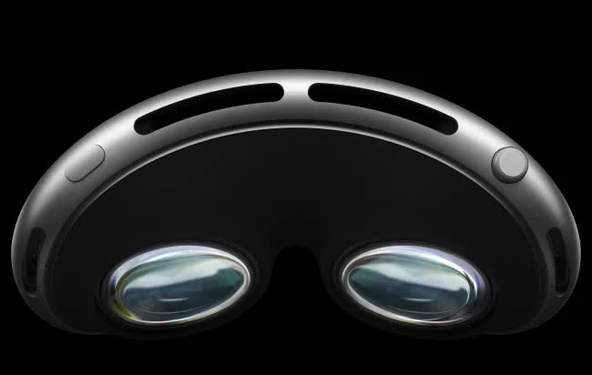
Apple Vision Pro: Innovation Breakthrough, Billionaire Toy, or Both?

Slide 19
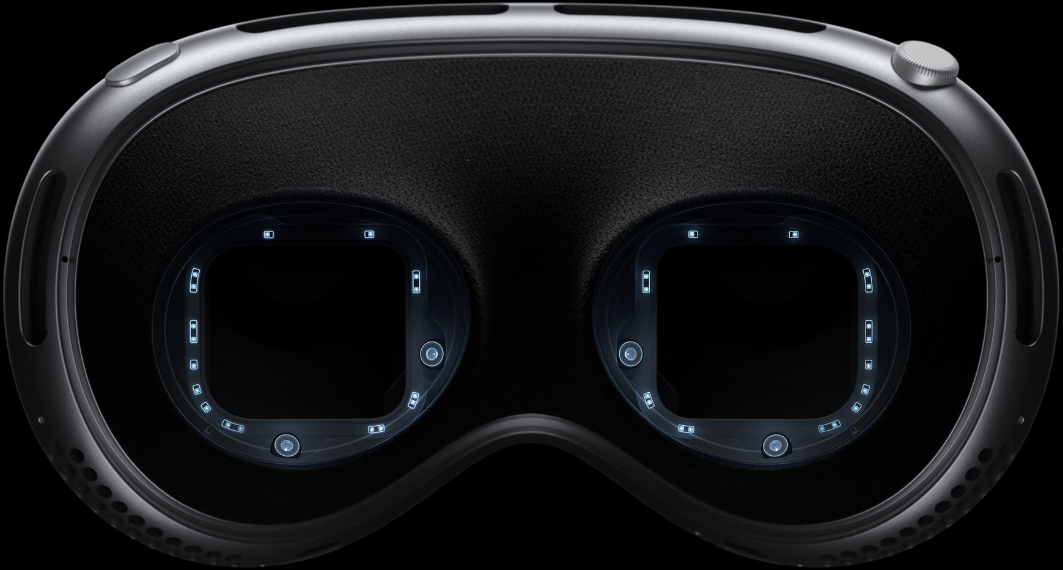
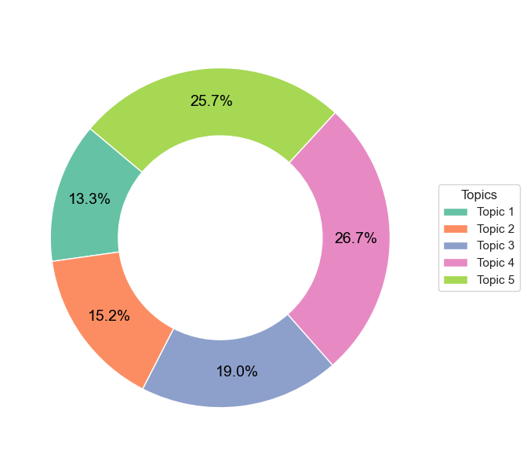
IPHONE 16E
AIRPODS PRO 2
APPLE VISION PRO
Great Tech. But… Will People Use It?
Topic 1: Price Doubts & Everyday Use
Topic 2: Video & Hand Tracking
Topic 3: Eye Tracking & Work Potential
Topic 4: Productivity Limitations
Topic 5: Developer Cost Concerns
Behind the Bite: Rethinking Apple’s Icons
Notes:
The Vision Pro triggers deep interest — but that interest quickly turns into skepticism.
Our topic modeling shows that nearly 52% of discussions focus on cost and practicality.
And even the other half, though intrigued by features like eye-tracking or gesture control, often question: ‘But what do I actually use this for?’

Slide 20
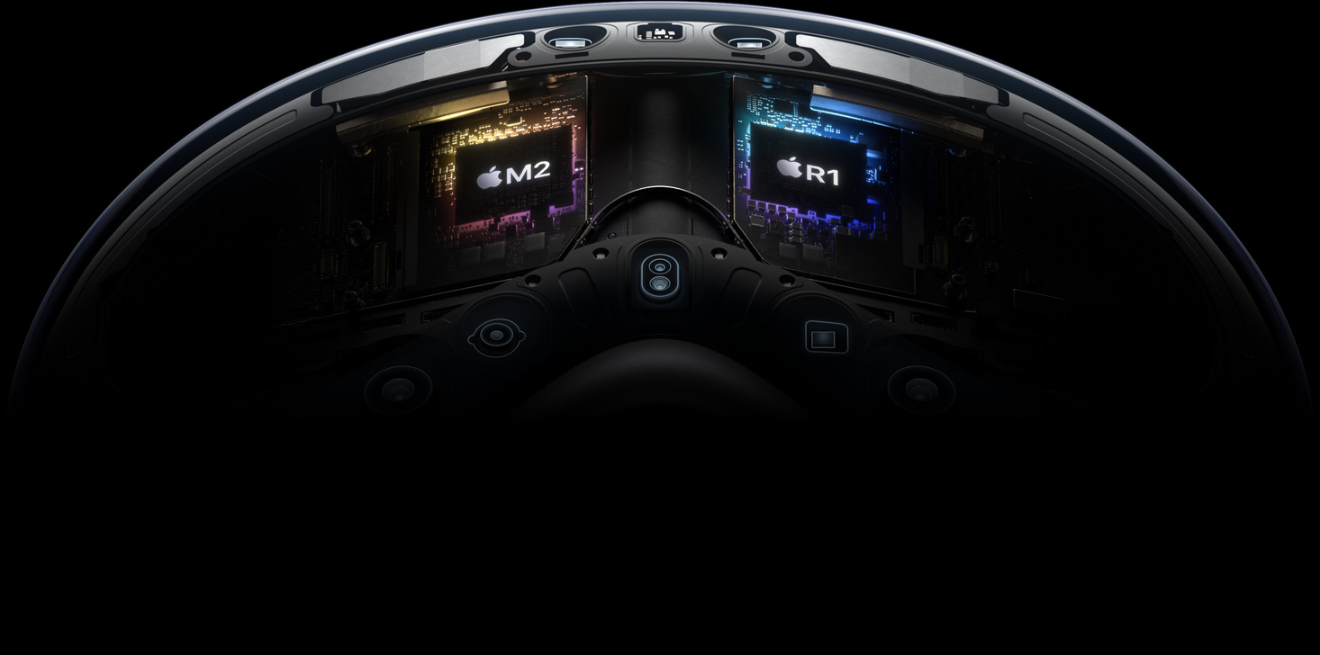
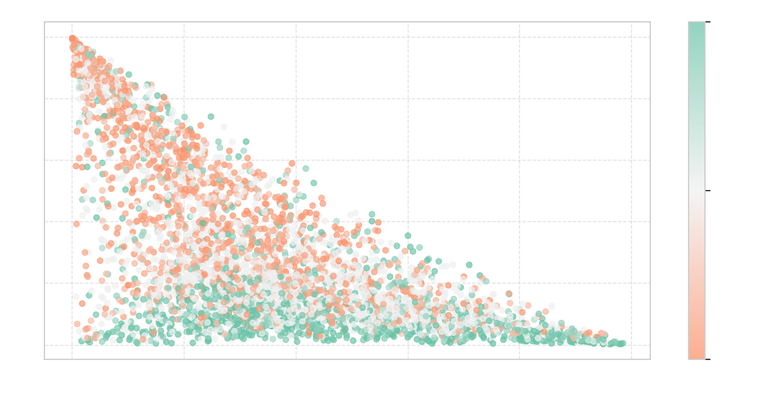
IPHONE 16E
AIRPODS PRO 2
APPLE VISION PRO
The Sentiment Behind the Noise
Behind the Bite: Rethinking Apple’s Icons
Notes:
X-axis (Innovation Score):
Higher = users talking about innovation, tech, futuristic use.
The graphs shows a low-to-mid innovation comments, and a tail of higher ones — suggesting mixed perception, but with a visible core of innovation praise.
2. Y-axis (Price Sensitivity):
Higher = users mentioning price, luxury, exclusivity.
There’s a strong cluster of high price sensitivity, meaning many people associate it with being expensive — pointing toward “billionaire toy”.
3. Color (Signed Sentiment):
Some people see it as innovative and worth it (bottom right, green).
Others are critical of the price and not impressed (top left, red). Many are in the middle zone — intrigued but unsure (gray zones).
Although there's a positive buzz about real innovation, the top left quadrant is full of critical and neutral sentiment, calling it expensive, excessive, etc.
The distribution and mixed coloring show that the product is greatly questioned for its price — making it not really cutting-edge and elitist.

Slide 21
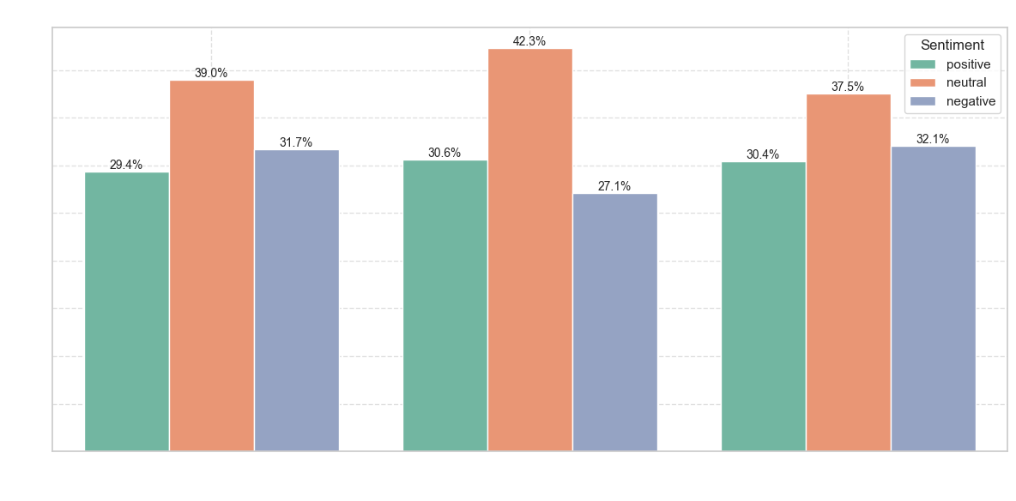
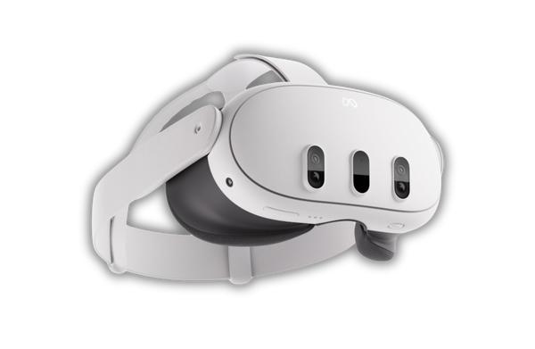
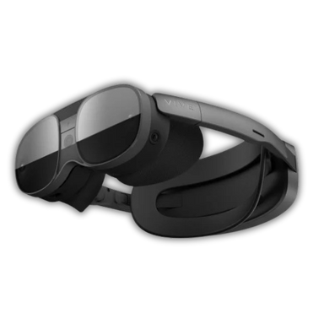
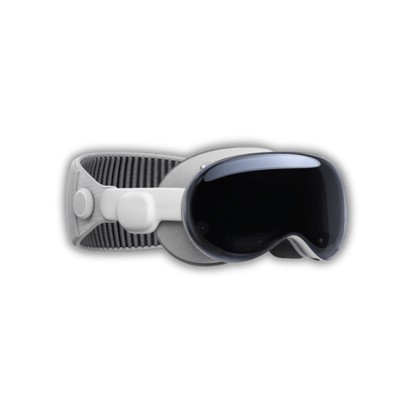
IPHONE 16E
AIRPODS PRO 2
APPLE VISION PRO
Competitor Comparison
Behind the Bite: Rethinking Apple’s Icons
Notes:
This chart shows the percentage distribution of sentiment for each major AR/VR brand. Here, Apple Vision Pro stands out — but not in a good way. It has the lowest proportion of positive sentiment near 29%, falling behind both Meta and HTC Vive. This indicates that fewer people are genuinely enthusiastic in their feedback.
What’s more concerning is that Apple also holds a high level of negative sentiment, at 31% — higher than Meta and just slightly better than HTC Vive. Combined with the boxplot we. This shows that while Apple has visibility, it is not translating into strong emotional endorsement.
These findings signal a clear challenge: the product is being noticed, but not celebrated.

Slide 22
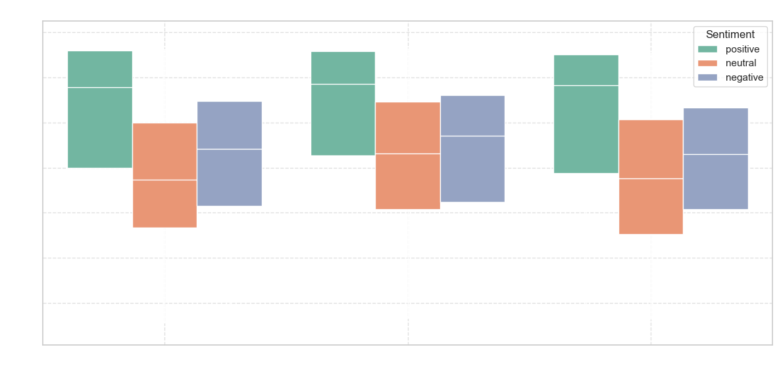
IPHONE 16E
AIRPODS PRO 2
APPLE VISION PRO
Competitor Comparison
Behind the Bite: Rethinking Apple’s Icons
Notes:
This boxplot uncovers a more nuanced insight: Apple Vision Pro shows the lowest median within the positive sentiment category compared to other brands. In simpler terms, even among positive mentions, the intensity of positivity is weaker for Apple than for competitors — users may say "good", but not "amazing".
This is a key signal. The buzz and expectations surrounding Apple’s launch often lead to a mismatch between what people imagine and what they experience — especially given the price tag and niche use cases. The drop in the median score likely reflects disappointment in value perception, or friction in usability for mainstream users.
On the other hand, Apple still shows lower median in the negative sentiment than Meta Quest, suggesting that while some users are underwhelmed, they’re not completely disillusioned. This gives us room to work.

Slide 23
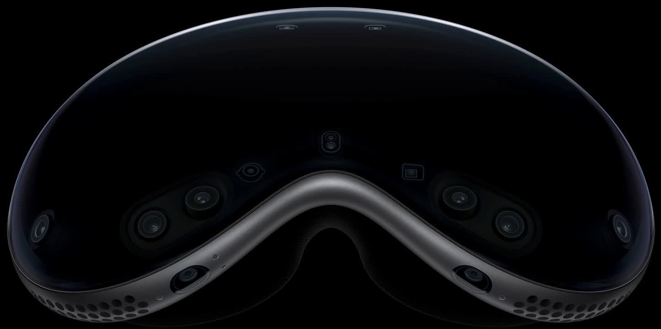



IPHONE 16E
AIRPODS PRO 2
APPLE VISION PRO
Beyond the Lens, by Apple
It’s not about what it looks like. It’s about what it lets you do: with your eyes, your hands, your world
“Built Differently” Campaign
Not just flashy demos, but deep-use storytelling
A director visualizing scenes on set
A neurosurgeon reviewing MRIs in spatial mode
An architect overlaying structural models onto real-world spaces
Behind the Bite: Rethinking Apple’s Icons
Notes:
Instead of the usual product highlights or flashy montages, we’re telling real stories of transformation. We follow different professionals before and after using Vision Pro, showing exactly how their process evolves — from 2D sketches to immersive walkthroughs.
These stories will be crafted as mini-documentaries, styled like Apple TV+ shorts — polished, cinematic, but personal. They’ll focus less on specs, and more on impact. These videos will be hosted in a new ‘Built Differently’ gallery on Apple’s platforms and — importantly — within the Vision Pro headset itself. It becomes a source of inspiration and validation for other professionals.

Slide 24
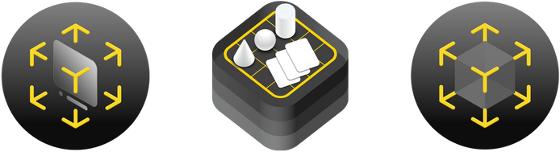
IPHONE 16E
AIRPODS PRO 2
APPLE VISION PRO
Beyond the Lens, by Apple
It’s not about what it looks like. It’s about what it lets you do: with your eyes, your hands, your world
“What Would You Build?” Challenge
Creators, students, and pros get to imagine what they would prototype on Vision Pro
ARCHITECTURE | HEALTH | ENTERTAINMENT | EDUCATION
Winners get featured in Apple’s showcase + developer tools
Behind the Bite: Rethinking Apple’s Icons
Notes:
We’re inviting professionals, educators, and creators into the story, through the ‘What Would You Build?’ challenge and a set of use cases that highlight the Vision Pro’s power in unexpected industries.
The message is clear: Vision Pro isn’t a toy. It’s a new canvas for those who build — not just the rich, but the curious, the innovative, and the people solving real problems. This is how we protect Apple’s leadership in innovation

Slide 25
IPHONE 16E
AIRPODS PRO 2
APPLE VISION PRO
Beyond the Lens, by Apple
It’s not about what it looks like. It’s about what it lets you do: with your eyes, your hands, your world
KPIs
≥ 70% of viewers who watch at least 75% of each video
1,000+ of valid submissions across all categories in the first 3 months
Behind the Bite: Rethinking Apple’s Icons
Notes:
We’re inviting professionals, educators, and creators into the story, through the ‘What Would You Build?’ challenge and a set of use cases that highlight the Vision Pro’s power in unexpected industries.
The message is clear: Vision Pro isn’t a toy. It’s a new canvas for those who build — not just the rich, but the curious, the innovative, and the people solving real problems. This is how we protect Apple’s leadership in innovation

Slide 26
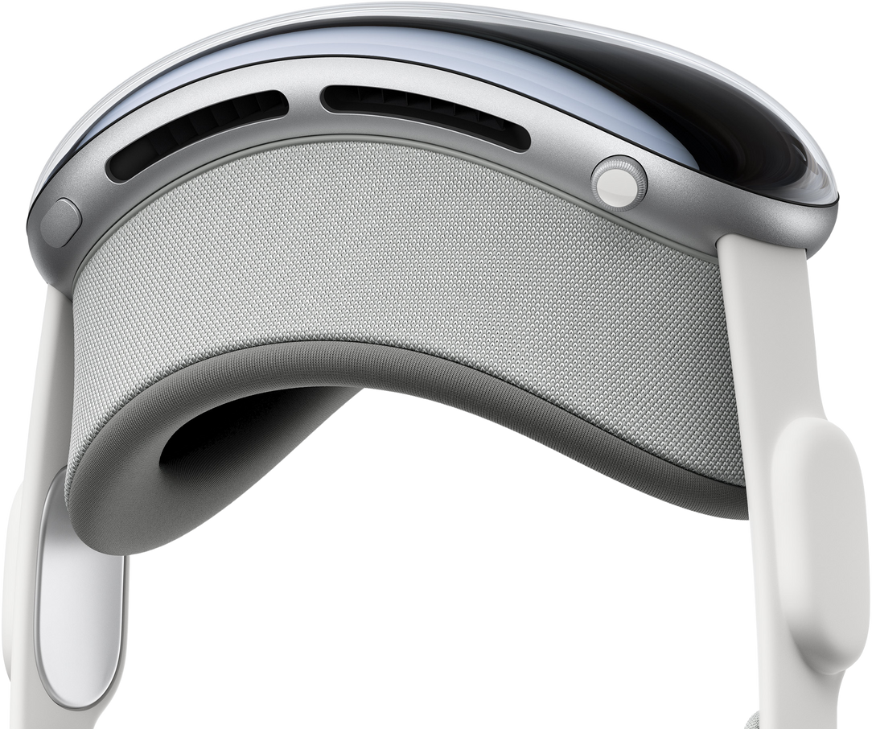
IPHONE 16E
AIRPODS PRO 2
APPLE VISION PRO
Before the Buzz
Pre-Campaign Markov Matrix
The Calm Before Conversion
High skepticism and low conversion rates
Many users remain stuck in “Observer” or “Explorer”
Significant risk of drop-off
Explorer
Observer
Tester
Skeptic
Converted
Behind the Bite: Rethinking Apple’s Icons
Notes:
This slide shows our baseline Markov matrix before launching the campaigns. You’ll notice that a majority of potential users remain skeptical or stay in the early adoption stages. Because of the high cost and limited real-world examples, very few are progressing to “Tester” or “Converted.” Additionally, those who become “Converted” show a relatively high churn rate (20% is a high churn, specially for a top-notch high-en product like this one) due to uncertainty about the product’s long-term value.

Slide 27
IPHONE 16E
AIRPODS PRO 2
APPLE VISION PRO
After the Buzz
Post-Campaign Markov Matrix
Riding the Conversion Wave
Reduced skepticism and higher engagement
Boost in transitions from “Observer” and “Explorer” to “Tester”
Higher retention among “Converted” users
Explorer
Observer
Tester
Skeptic
Converted
Behind the Bite: Rethinking Apple’s Icons
Notes:
After implementing our “Built Different” and “What Would You Build?” campaigns, we expect to see the following shifts in user behavior.
By showcasing real-life transformations and inviting professionals to explore innovative use cases, skepticism goes down.
People in “Observer” and “Explorer” are more likely to move forward, and “Tester” converts at a higher rate. We also see a lower risk of churn among those already “Converted,” reflecting stronger confidence in the product’s value.

Slide 28
View online at apple.com or on the Apple TV app

